Slide 1
8051
ARCHITECTURE
www.vectorindia.org

Slide 2
Features (AT89C51)
Employs CISC, Harvard architecture
8 bit CPU (based on ALU size)
40 pin DIP(40(physical)=32_I/O+8,64(logical)=(24*2)+16)
4K on chip ROM (differ based on later versions)
128 bytes of on chip RAM
128 bytes address space reserved for SFRs, available ONLY 21 bytes/sfr’s
4 ,8-bit parallel port peripherals (P0, P1, P2 & P3)
Two 16 bit timers/counters peripheral (TIMER0, TIMER1)
Full Duplex UART serial peripheral
On-chip clock oscillator requires ext crystal
Interrupt Control logic which supports 6 sources,5 vectored interrupts
Can support up to max 64k of ROM (hence 60k ext)
Can support up to addition max 64k ex-RAM

Slide 3
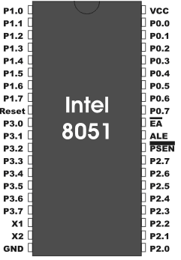
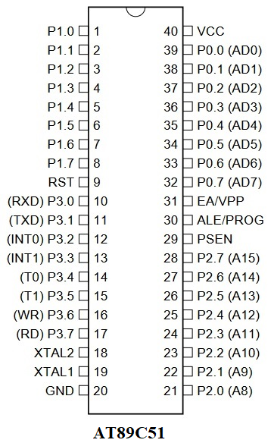
Pin-out diagram

Slide 4
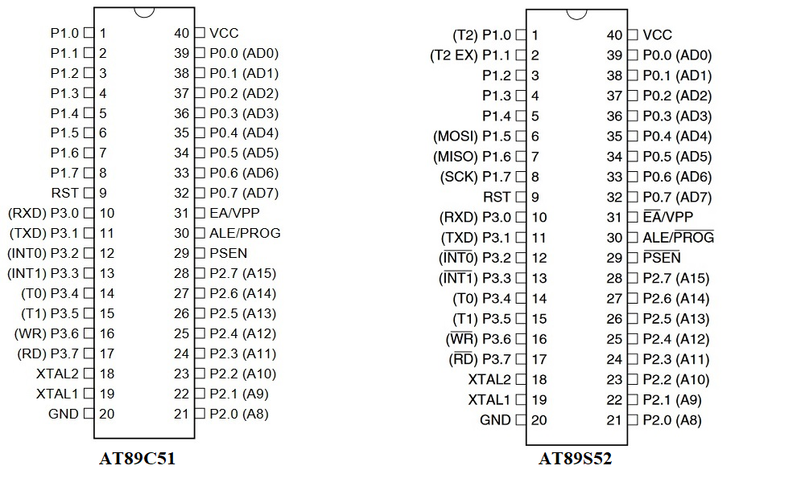
Pin-out diagram

Slide 5
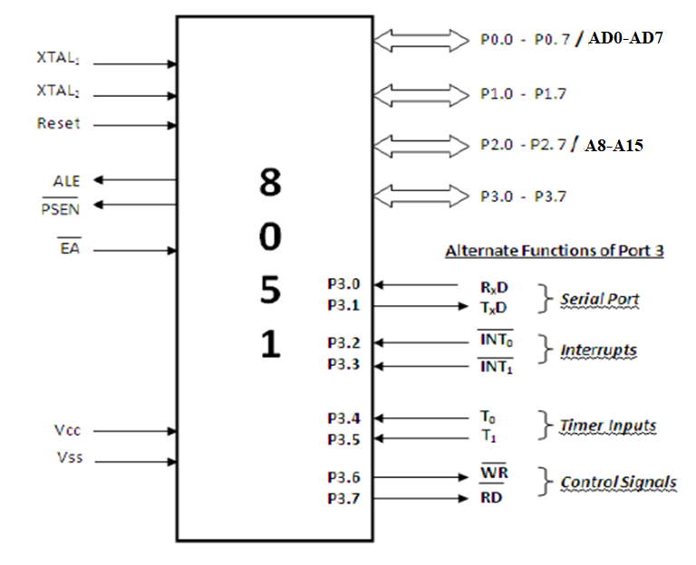
Simplified Pin Diagram

Slide 6
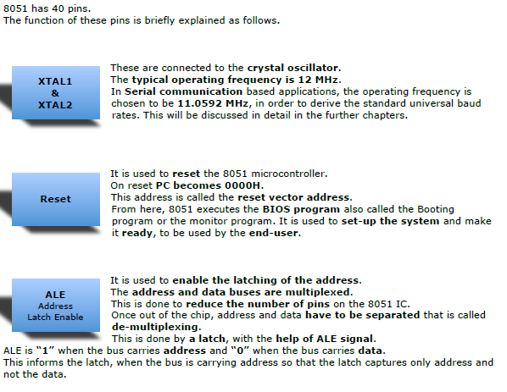

Slide 7
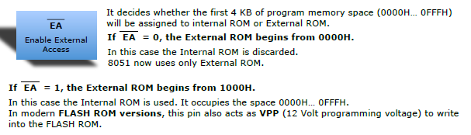
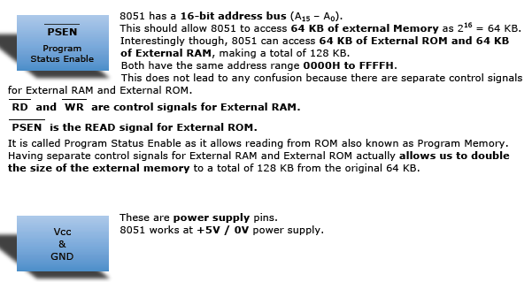

Slide 8
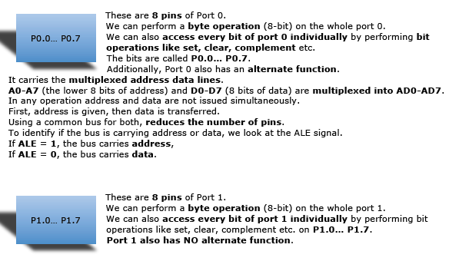

Slide 9
